Slide 1
Intro SQL DDL Commands
SQL: Schema Definition and Constraints
Chapter 6 week 6

Slide 2
Introduction to SQL
A standard language used in most DBMS.
Well, not as standardized as one might hope
it keeps involving and growing
Vendors have the tendency to add “unique” features.
Pronounced as “S-Q-L” or “Sequel.”
Both as a DDL and DML language.
DDL (Data Definition Language): define the schema of the database.
DML (Data Manipulation Language): provides commands to manipulate the database (query, insert, update, delete).

Slide 3
SQL DDL Commands
CREATE: to define new tables (to define relation schemas)
DROP: to delete table definitions (to delete relation schemas)
ALTER: to change the definitions of existing tables (to change relation schema)
Other features as DDL
Specify referential integrity constraints (FKs)
Specify user-defined attributes constraints

Slide 4
Create Table command
The Create Table Command The create table command defines each column of the table uniquely. Each column has minimum of three attributes.
Name
Data type
Size(column width).
Each table column definition is a single clause in the create table syntax. Each table column definition is separated from the other by a comma. Finally, the SQL statement is terminated with a semicolon.

Slide 5
The Structure of Create Table Command
Table name is Student
Column name | Data type | Size
reg_no | INT
name | CHAR | 30
dob | DATE
city | VARCHAR | 50
Example:
CREATE TABLE Student (
reg_no INT NOT NULL,
name CHAR(30),
dob DATE,
city VARCHAR(50)
);

Slide 6
The TRUNCATE Command
Syntax:
TRUNCATE TABLE <Table_name>
Example:
TRUNCATE TABLE Student;

Slide 7
The RENAME Command
Syntax:
RENAME <OldTableName> TO <NewTableName>
Example:
RENAME TABLE Student TO stu;

Slide 8
The DROP TABLE Command
Syntax:
DROP TABLE <table name>
Example:
DROP TABLE student;

Slide 9
The ALTER Table Command
By The use of ALTER TABLE Command we can modify our exiting table.
Adding New Columns
Syntax:
ALTER TABLE <table_name>
ADD (<NewColumnName> <Data_Type>(<size>),......n)
Example:
ALTER TABLE `student` ADD `Age` INT NOT NULL ,
ADD `Marks` INT NOT NULL ;
The Student table is already exist and then we added two more columns Age and Marks respectively, by the use of above command.

Slide 10
ALTER Table Continued
Modifying Existing Table
Syntax:
ALTER TABLE <table_name> MODIFY (<column_name> <NewDataType>(<NewSize>))
Example:
ALTER TABLE Student MODIFY (Name Varchar(40));
The Name column already exist in Student table, it was char and size 30, now it is modified by Varchar and size 40.

Slide 11
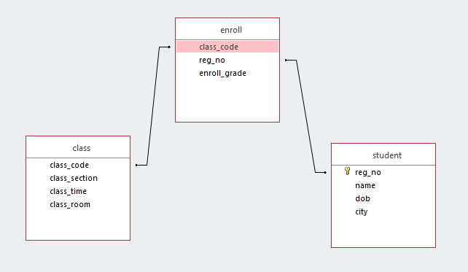
ALTER Table Continued
Consider the following tables and the
their relationships, we will use them in next slides.

Slide 12
ALTER Table Continued
Modifying an attribute as primary key
Syntax:
ALTER TABLE <table_name> ADD CONSTRAINT <constraint_name> PRIMARY KEY <(PK)>
Example:
ALTER TABLE class ADD CONSTRAINT PRIMARY KEY ( CLASS_CODE );

Slide 13
ALTER Table Continued
Modifying an attribute as foreign key
Syntax:
ALTER TABLE <table_name> ADD
CONSTRAINT <constraint_name> FOREING KEY (<FK>)
REFERENCES <table_name> <PK>;
Example:
ALTER TABLE eroll ADD CONSTRAINT Reg_no_FK FOREIGN KEY ( Reg_no ) REFERENCES student( Reg_no )
If table errol is created first you can not use Reg_no as foreign key in create command, instead to use the command above the define the FK.

Slide 14
ALTER Table Continued
Adding an attribute as foreign key
ALTER TABLE enroll ADD CLASS_CODE INT NOT NULL;
ALTER TABLE EROLL ADD CONSTRAINT FK_CLASS_CODE
FOREIGN KEY ( CLASS_CODE ) REFERENCES class
( CLASS_CODE );

Slide 15
Create the COMPANY Database
To create
create datatbase COMPANY;
To use (or switch to) the database
use COMPANY;
Subsequent commands will operate on the COMPANY database by default.

Slide 16
Exercise 1
CREATE TABLE DEPARTMENT (
dname VARCHAR(10) NOT NULL,
did INTEGER Default 0,
managerid INTEGER,
budget REAL,
PRIMARY KEY (did),
UNIQUE (dname),
FOREIGN KEY (managerid)
REFERENCES EMPLOYEE (eid));
What does the default 0 constraint means?
What does the “UNIQUE” clause specifies?
What is the problem with this create command, specify?
How could we have defined the did FK in EMPLOYEE?

Slide 17
Foreign key with cascade delete
Cascade delete in SQL
A record in the parent table is deleted, then the corresponding records in the child table will automatically be deleted.
CREATE TABLE child_table ( column1 datatype [ NULL | NOT NULL ], column2 datatype [ NULL | NOT NULL ], ... CONSTRAINT fk_name FOREIGN KEY (child_col1, child_col2, ... child_col_n) REFERENCES parent_table (parent_col1, parent_col2, ... parent_col_n) ON DELETE CASCADE
[ ON UPDATE { NO ACTION | CASCADE | SET NULL | SET DEFAULT } ] );

Slide 18
FK CONSTRAINT ON UPDATE
ON UPDATE Optional. It specifies what to do with the child data when the parent data is updated. You have the options of. NO ACTION, CASCADE, SET NULL, or SET DEFAULT
NO ACTION
It is used in conjunction with ON DELETE or ON UPDATE. It means that no action is performed with the child data when the parent data is deleted or updated.
CASCADE
It is used in conjunction with ON DELETE or ON UPDATE. It means that the child data is either deleted or updated when the parent data is deleted or updated.
SET NULL
It is used in conjunction with ON DELETE or ON UPDATE. It means that the child data is set to NULL when the parent data is deleted or updated.
SET DEFAULT
It is used in conjunction with ON DELETE or ON UPDATE. It means that the child data is set to their default values when the parent data is deleted or updated.

Slide 19
Fk CONSTRAINT Example
CREATE TABLE products (
product_id INT PRIMARY KEY,
product_name VARCHAR(50) NOT NULL,
category VARCHAR(25) );
CREATE TABLE inventory (
inventory_id INT PRIMARY KEY,
product_id INT NOT NULL,
quantity INT, min_level INT,
max_level INT,
CONSTRAINT fk_inv_product_id
FOREIGN KEY (product_id)
REFERENCES products (product_id)
ON DELETE CASCADE );

